Slide 1
Text Based Emotion Classifier
G. Dileep Chandu -20BCI7313
G. Keerthi Vardhani-20BCE7620
G. Vyshnavi -20BCI7004

Slide 2
Abstract
Emotion can be articulated in several means that can be seen, like speech and facial expressions, written text, and gestures. Emotion recognition in a text document is fundamentally a content-based classification issue, including notions from natural language processing (NLP).
Detecting emotional state of a person by analysing a text document written by him/her appear challenging but also essential many times due to the fact that most of the times textual expressions are not only direct using emotion words but also result from the interpretation of the meaning of concepts and interaction of concepts which are described in the text document.
Recognizing the emotion of the text plays a key role in the human-computer interaction. Emotional recognition has arisen as an essential field of study that can expose a variety of valuable inputs.
In this project, we try to the classify the text according to the emotion that it represents. Emotion is expressed as anger, disgust, fear, joy, neutral, sadness, shame and surprised. This is multi class sentiment analysis problem.

Slide 3
Introduction
Emotion classification is the process of identifying and categorizing the emotional state of a person based on the text they have written or spoken. With the rise of social media and online communication, the need for automatic emotion detection has become increasingly important. Emotion detection can be useful in a variety of applications such as customer service, psychological research, and even marketing. By analyzing the text, natural language processing algorithms can detect various emotions such as happiness, sadness, anger, and fear. However, accurately detecting emotions from text is a complex task due to the subjective nature of emotions and the variability of language used to express them. Therefore, researchers and developers are constantly exploring new methods and techniques to improve the accuracy of emotion detection from text.

Slide 4
System Requirements (Mention hardware requirements and software libraries)
Hardware :
Ram:4GB
Processor: intel i3,7th gen
Software:
Google Colab.
Jupyter notebook.
Anaconda.
Libraries Used:
Numpy
Pandas
NLTK
Seaborn
Sk-learn
Algorithms:
Logistic Reression
Multinomial NB
SVM

Slide 5

Need of proposed Work(Related to Society)
Generally ,machines (computers) can’t understand and express the feelings humans. But by using NLP through this project machines can also understand and express the feelings
Emotion recognition has been important because emotions are taking different forms like stress .
In order to cure the patients’ even health psychologists are studying for emotion extraction for establishing the link between physical health, stress and emotions

Slide 6
Related Work (details regarding existing work)
Donngliang Xu et al developed a microblog emotion classification model, named CNN_Text_Word2vec, based on the convolutional neural network (CNN). The method effectively extracted the significant features and also achieved a good classification effect.
Srishti Vashishtha et al developed the sentiment analysis of social media posts based on a set of fuzzy rules, which involved multiple lexicons and datasets. The fuzzy system integrated the Natural Language Processing (NLP) techniques and Word Sense Disambiguation based on a novel unsupervised nine fuzzy rule-based system for classification.

Slide 7
Data flow diagram of proposed work (like flow chart)
Text
Tokenization
Stop word,
punctuation removal
Identify emotion key word
Analysis
Predict Emotion

Slide 8
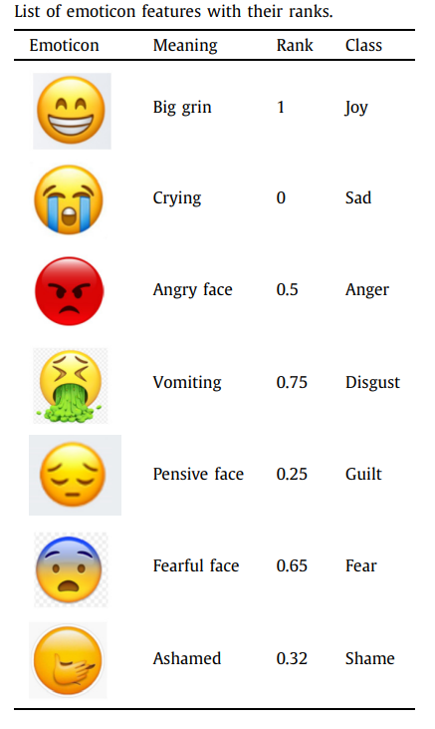
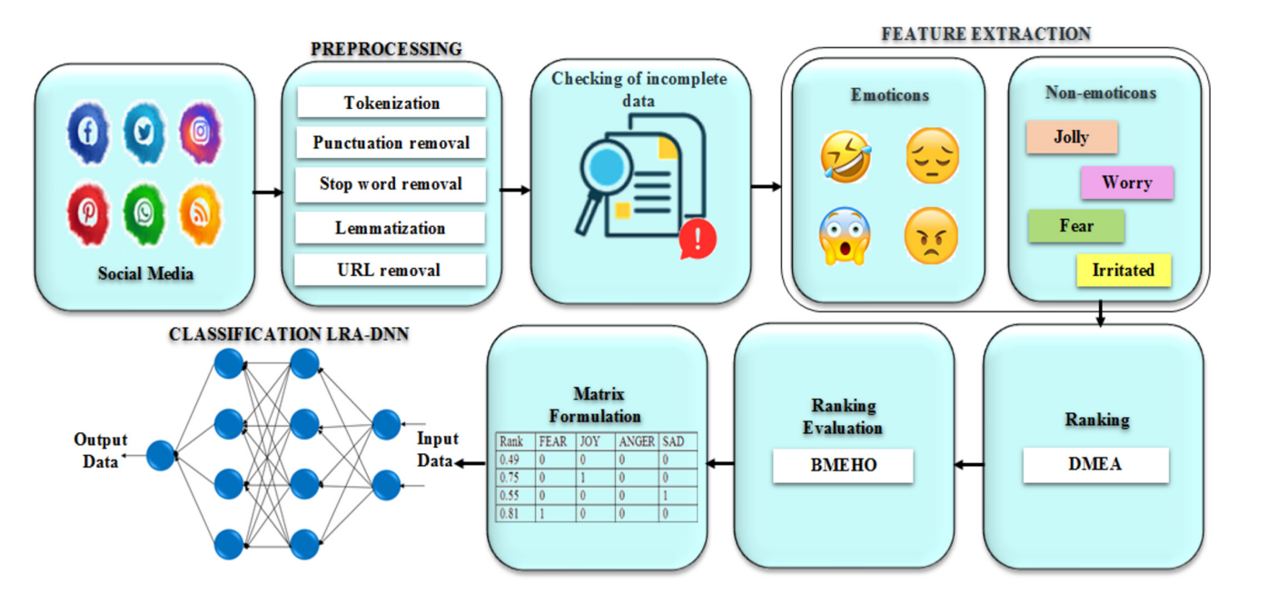
Fig. 1. Architecture of the proposed work

Slide 9
Data set and features Details
--------> data set before pre-prosessing
---------> data set after pre prosressing
Features of the data set :
emotion - output
text-input

Slide 10
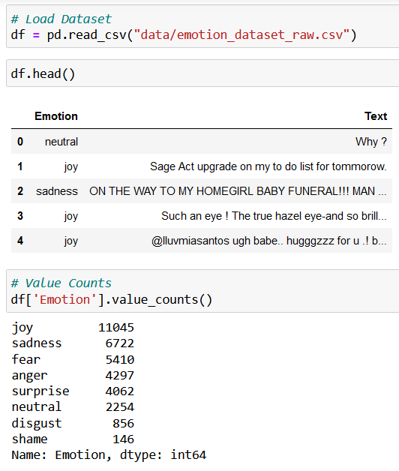
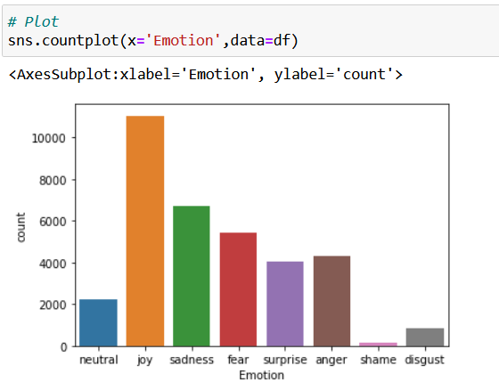
Pre-processing with screenshots
In preprocessing we perform data cleaning and text cleaning

Slide 11
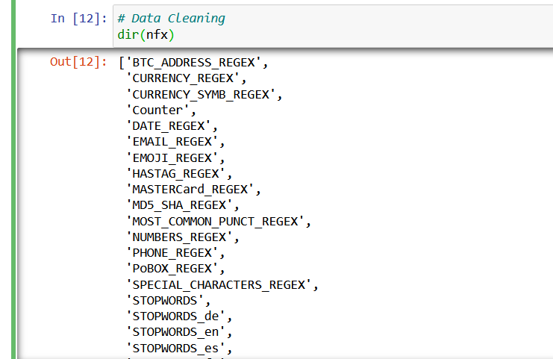
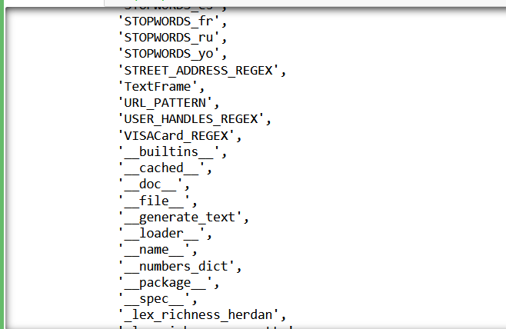
Data cleaning

Slide 12
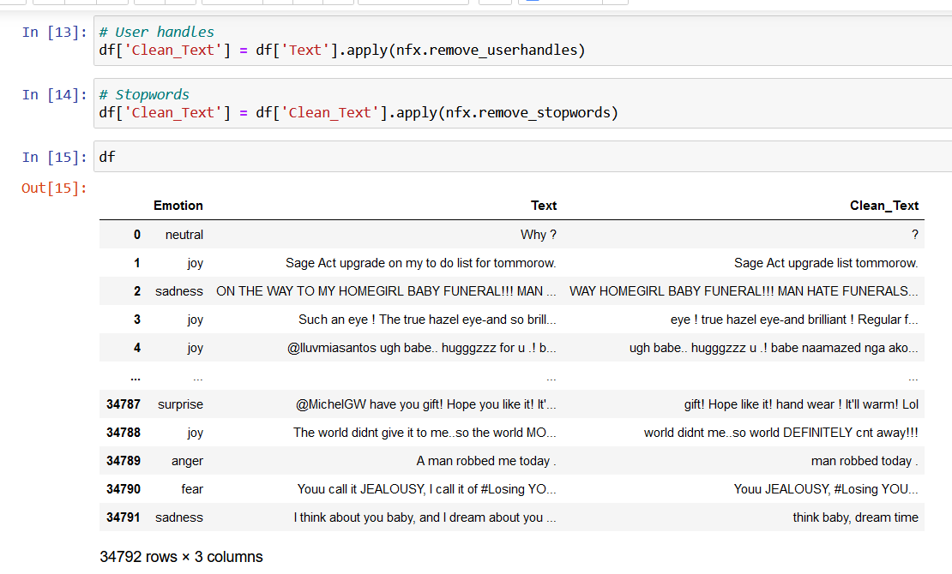
Text cleaning

Slide 13
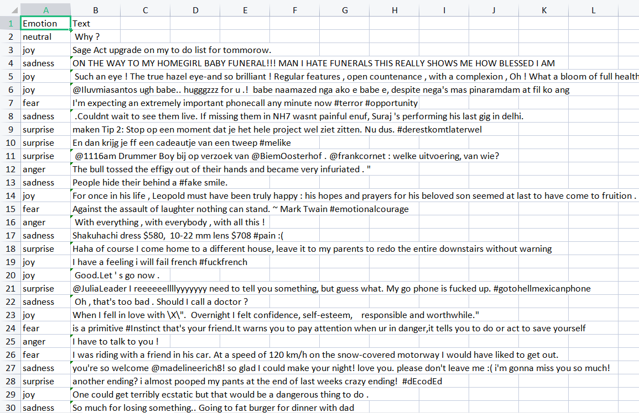
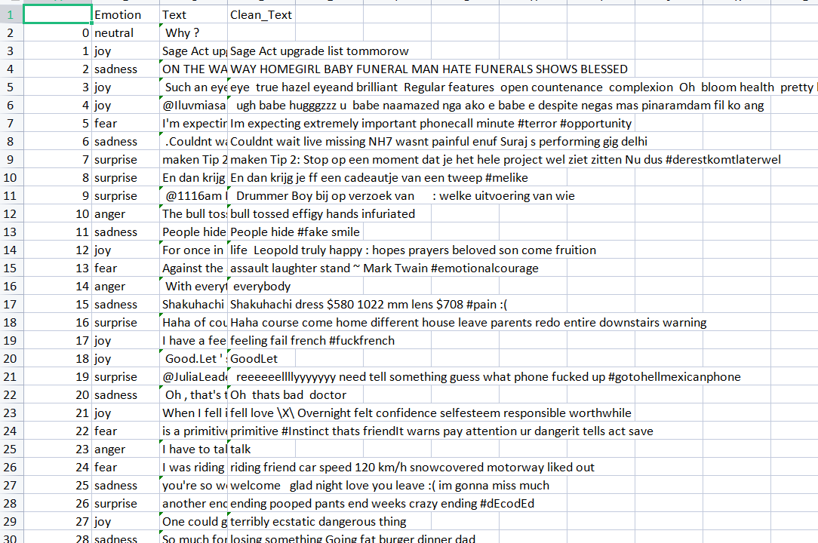
BEFORE TEXT CLEANING
AFTER TEXT CLEANING

Slide 14
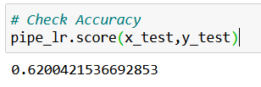
Each Module status, coding with output
SKLEARN
status: this module is used to build pipeline
coding: # Build Pipeline
from sklearn.pipeline import Pipeline
# LogisticRegression Pipeline
pipe_lr =
Pipeline(steps=[('cv',CountVectorizer()),('lr',LogisticRegression())])
# Train and Fit Data
pipe_lr.fit(x_train,y_train)
# Check Accuracy
pipe_lr.score(x_test,y_test)
output:
89.9

Slide 15
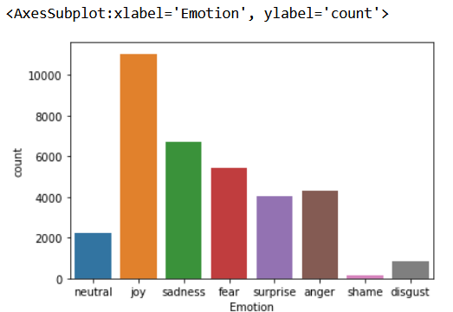
SEABORN
status: this module is used to plot graph
coding: # Plot
sns.countplot(x='Emotion',data=df)
output:

Slide 16
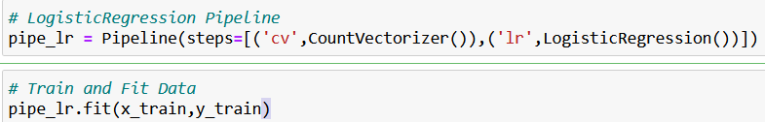
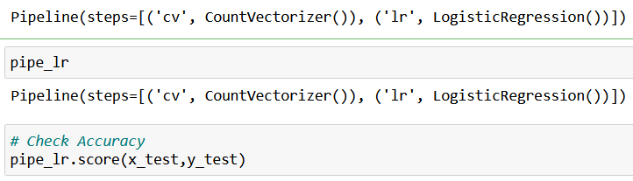
Trained Model with its parameter
LOGISTIC REGREESION - ALGORITHM
COUNT VECTORIZER -ALGORITHM
The parameters in the logistic regression algorithm are:
Emotion - Dependent variable
Text - Independent variable
89.9

Slide 17
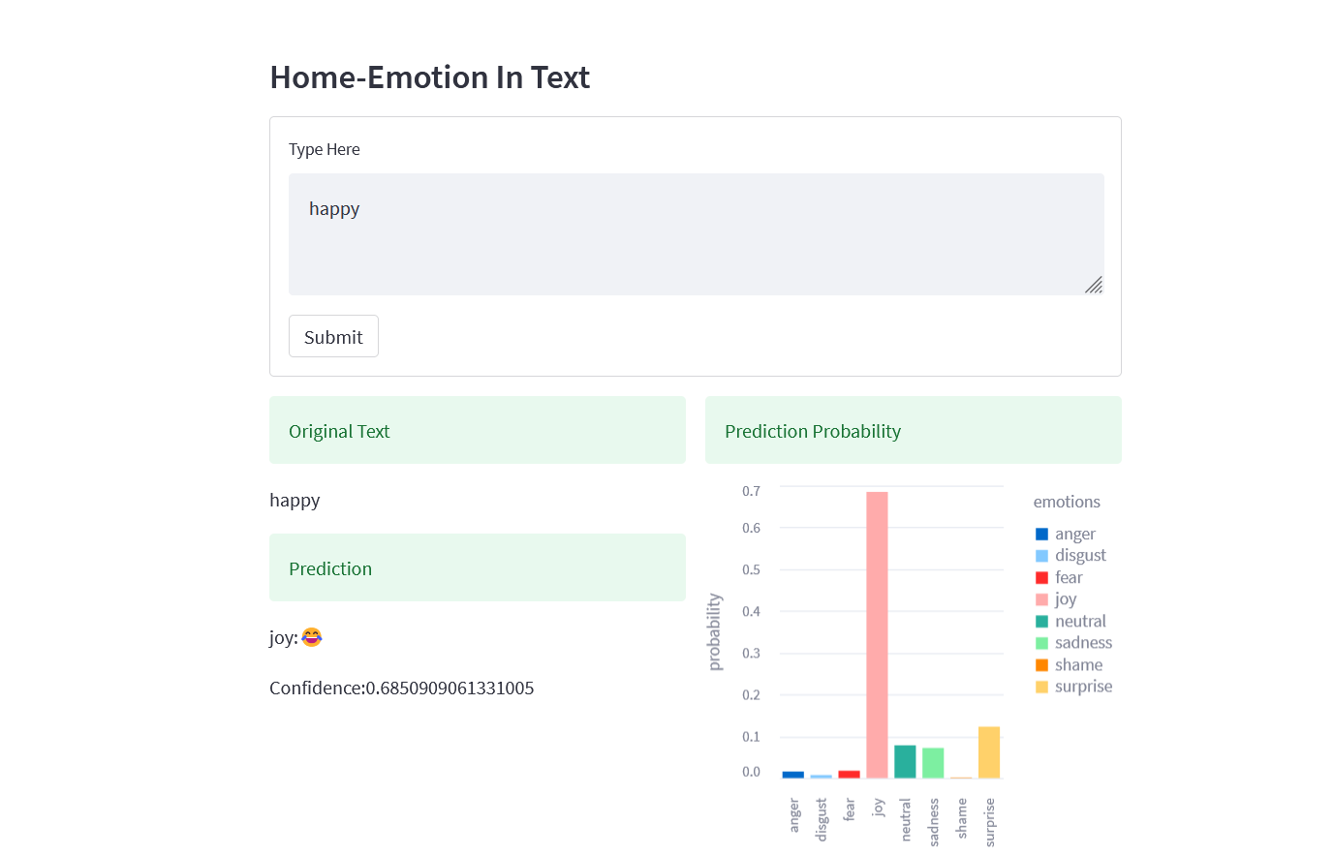
App

Slide 18
References(journal, web site references)
https://reader.elsevier.com/reader/sd/pii/S2772528622000103?token=45A38BD6FD4A3910277CAE529624524F6976A5BCB8A1EADD30AAA3982C4F0497D8A468883B2B6D9B8739577B6238B052&originRegion=eu-west-1&originCreation=20230202080255
https://onlinelibrary.wiley.com/doi/full/10.1002/eng2.12189

